Slide 1
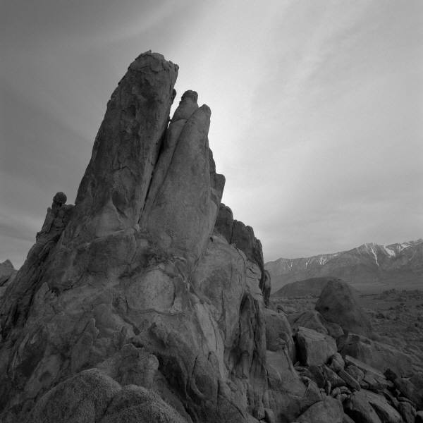
GPU-PSO: Parallel Particle Swarm Optimization Approaches On Graphical Processing Unit For Constraint Reasoning: Case Of Max-CSPs
University of West Of England Bristol
Student Name: Newton Nwaonumah Elemchukwu
Student id.: 18041186
Module Tutor: Mehmet Aydin
Date: 11-05-2018

Slide 2
Constraint Satisfaction Problems (CSPs)
Number of variables are finite V, V1...Vn
Equally finite set of constraints C0, C1, ...Cn
Every constraint places a limit on the values that can be assigned to variables
Assignment of values to all or some variables creates a state
Key challenge: ensuring that value assignments to variables do not violate constraints
Complete Assignment accounts for all values
The ideal solution should create complete assignment

Slide 3
Finding an efficient resolution for Max-CSP
Different optimization solutions such as backtracking, Forward checking, Labelling
Particle Swarm Optimization (PSO)
Solves CSPs efficiently by cutting down time needed to explore solutions in the search space
Maximizes or minimizes the objective function by finding values for the variables to satisfy the constraints
Downside of PSO: computationally expensive when faced with very large instances
Goal: Solve Max-CSPs with large instances efficiently
Architecture: GPU (parallel computing framework)
Proposed Solutions:
Parallel GPU-PSO for Max-CSPs
Distributed PSO for Max-CSPs (GPU-DPSO)

Slide 4
Background And Related Work
Background
Optimization problems tend to be complex and computationally expensive (have high CPU time consumption)
Different algorithms with relative optimality become severely challenged when faced with resolving large sized problems
Artificial intelligence applications need to resolve CSP for their planning, scheduling and resource allocation functions
CSP solutions aim at the greatest or complete instantiation of variables to satisfy constraints
Related Works
Several attempts have been made to resolve the CSP conundrum using PSO
Dynamic Distributed Double Guided Particle Swarm Optimization for Max-CSPs (D3GPS O) uses a distributed approach to solve CSP problems collaboratively
Global dynamic of D3GPS breaks swarms into sub swarms with their unique optimising PSO algorithms

Slide 5
Key Concepts
Constraint satisfaction problems require objects to have states that satisfy a set of constraints to a level that is optimal or complete
Solutions should maximize the objective function
Maximal Constraint Satisfaction Problems (Max-CSPs ) do not have solutions to satisfy all their constraints:
The best solution satisfies as many constraints as possible
GPU architecture offers a parallel computing framework for efficient, high speed and high performance implementation of Max-CSPs

Slide 6
Key Concepts
Particle Swarm Optimization (PSO) provides one of the most efficient solutions to large sized CSPs using GPU architecture
Parallelism significantly reduces data transfer speed delays and memory usage
Fitness is the best value for objective functions

Slide 7
Experimentation with Proposed MAX CSP Resolution Algorithms
Algorithms
Parallel GPU-PSO for Max-CSPs
Distributed PSO for Max-CSPs (GPU-DPSO)
Computing Framework: CPU versus GPU
Task: Validate Parallel algorithms on randomly generated CSPs for all CSPs types : easy, hard and transition phase
Performance measures:
Execution time: the time it takes for resolving the CSP challenge
Fitness: The number of constraints that are violated. This shows the quality of the solution.

Slide 8
Performance Analysis & Results: GPU-PSO &CPU-PSO, CPU & GPU
Comparing results between GPU-PSO and CPU-PSO
Execution time:
GPU-PSO took 4.6 times less than CPU-PSO
GPU-DPSO took 1.318 times less than GPU-PSO
Fitness Ratio
Average fitness ratio for GPU-DPSO was 1
whereas average for GPU-PSO was less than 1
This gives GPU-DPSO algorithm a far better performance ratio than GPU-PSO algorithm

Slide 9
Conclusion
Constraint satisfaction problems remain very hard and complex for legacy methods to resolve
Therefore the need to find more efficient methods and computing frameworks like the parallel algorithms and the high performance GPU architecture
GPU architecture was found to be especially effective and efficient for solving CSPs with large instances
Of the two PSO algorithms tested, the distributed approach was found to be more efficient perhaps due to an efficient load balancing mechanism

Slide 10
References
Sadeh, N. and Fox, M. (1991). Variable and Value Ordering Heuristics for Hard Constraint Satisfaction Problems: An Application to Job Shop Scheduling. Ft. Belvoir: Defense Technical Information Center.
Mikki, S. and Kishk, A. (2008). Particle swarm optimization. San Rafael, Calif. (1537 Fourth Street, San Rafael, CA 94901 USA): Morgan & Claypool Publishers.
Hamadi, Y. (2013). Combinatorial Search: From Algorithms to Systems. Berlin, Heidelberg: Springer.

